Slide 1
ACE E-Commerce Management System
Innovating Digital Commerce...

Slide 2
Table of contents
01
02
03
05
06
07
04
Introduction
Product Infographic
Core Functionalities
Performance and Reliability
08
A Comprehensive Solution
Technical Backbone
Trust and Integrity
Beyond the Basics

Slide 3
01
Introduction

Slide 4
Introduction
User-Centric Features
Efficient Product and Order Management
Enhancing the interaction between customers and sellers for an improved shopping experience.
Streamlined processes for a smoother online shopping journey.

Slide 5
02
Product Infographic

Slide 6
Product infographic
Visuals
Reviews Section
Showcase the design of your product
What your customers think of your product
Price
Users
Share the cost and price with investors
Speak about the target audience
Availability
Updates
When is the product expected to be ready?
Do you plan on updating it?

Slide 7

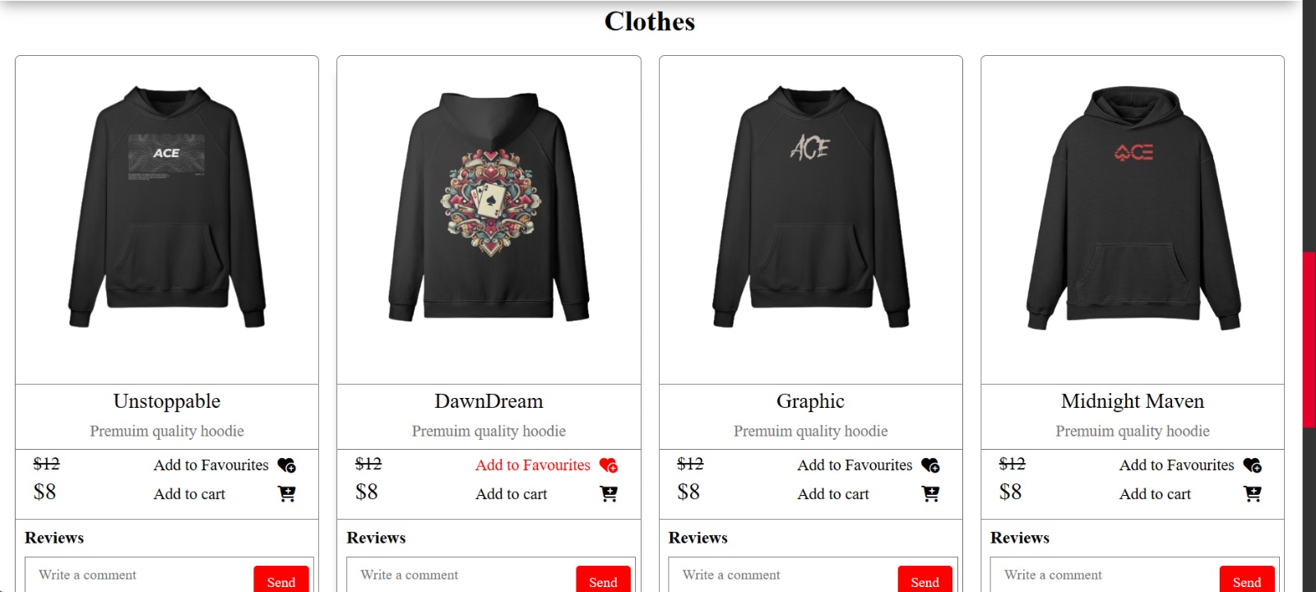
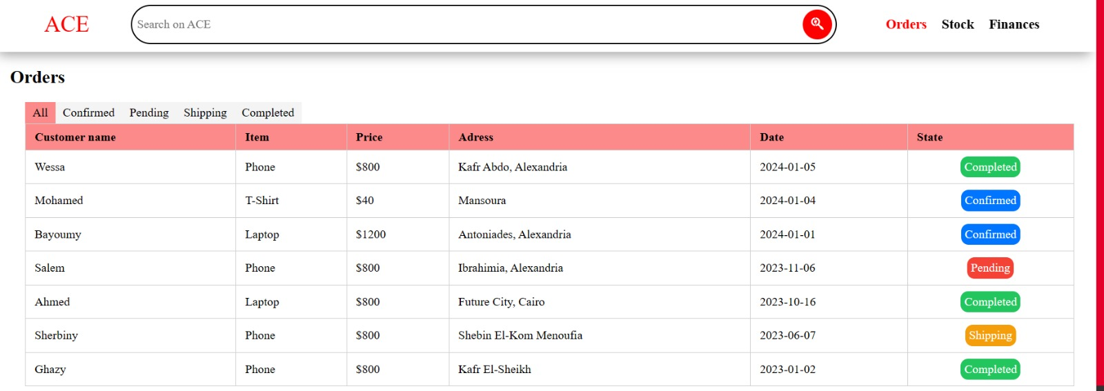
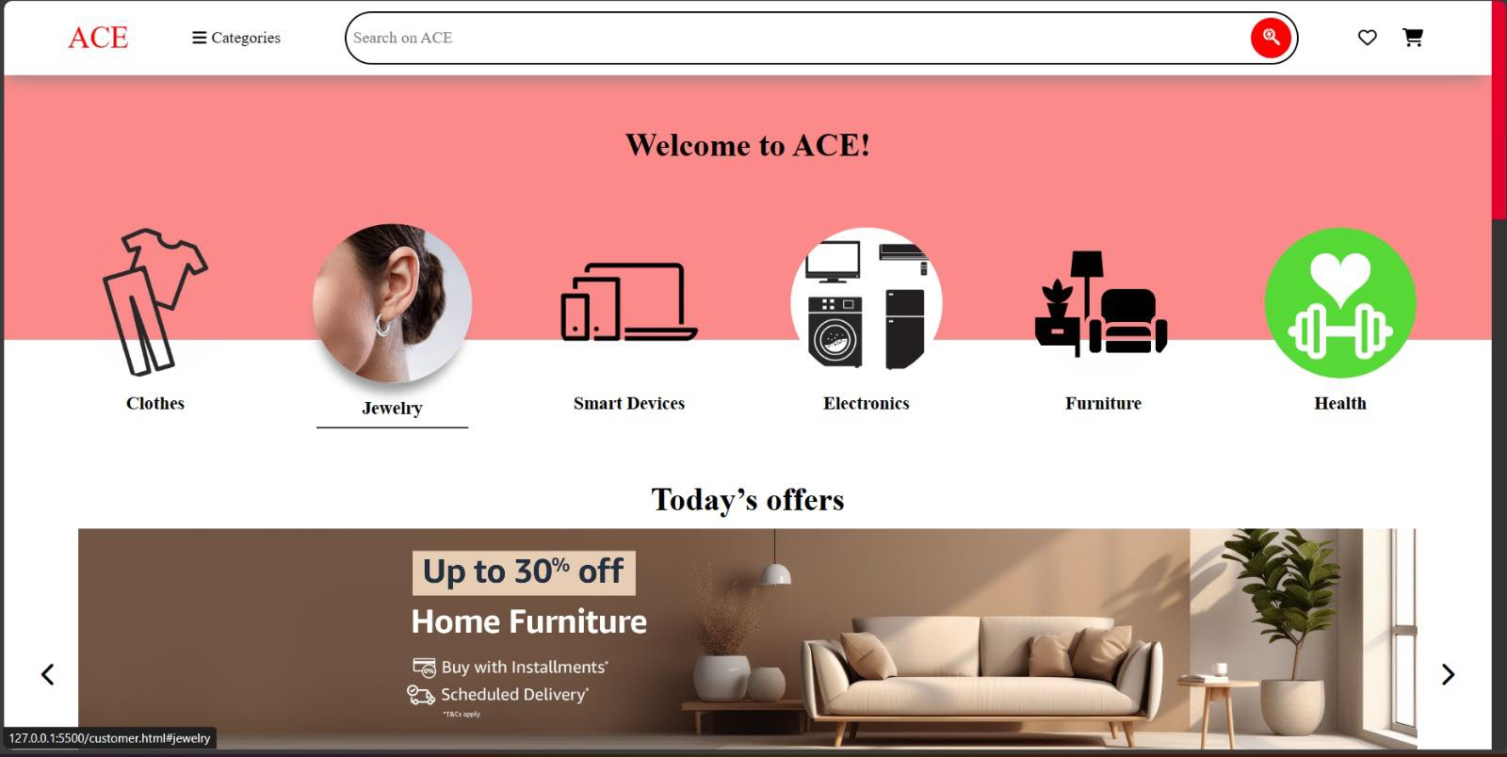
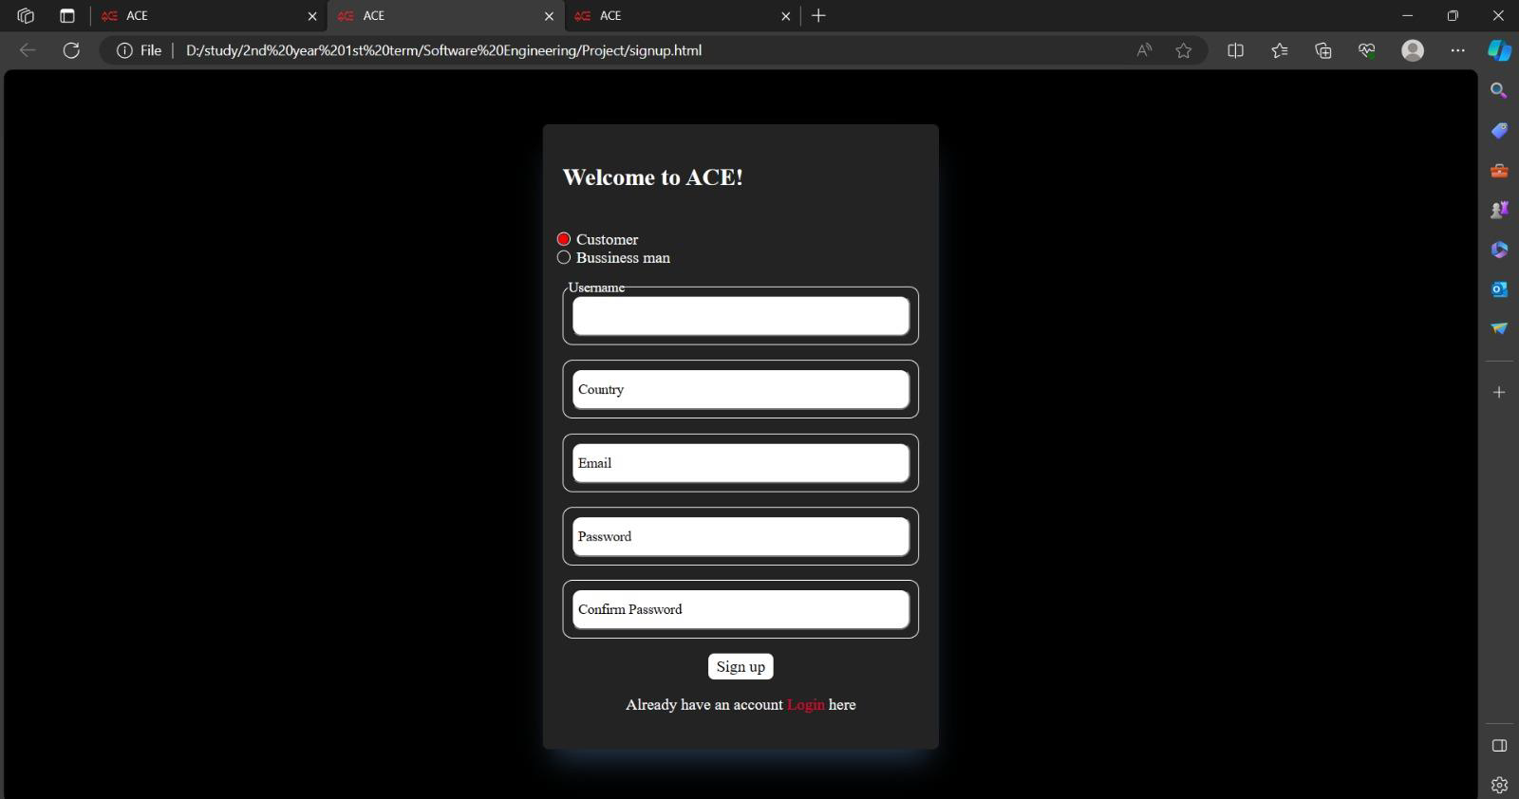
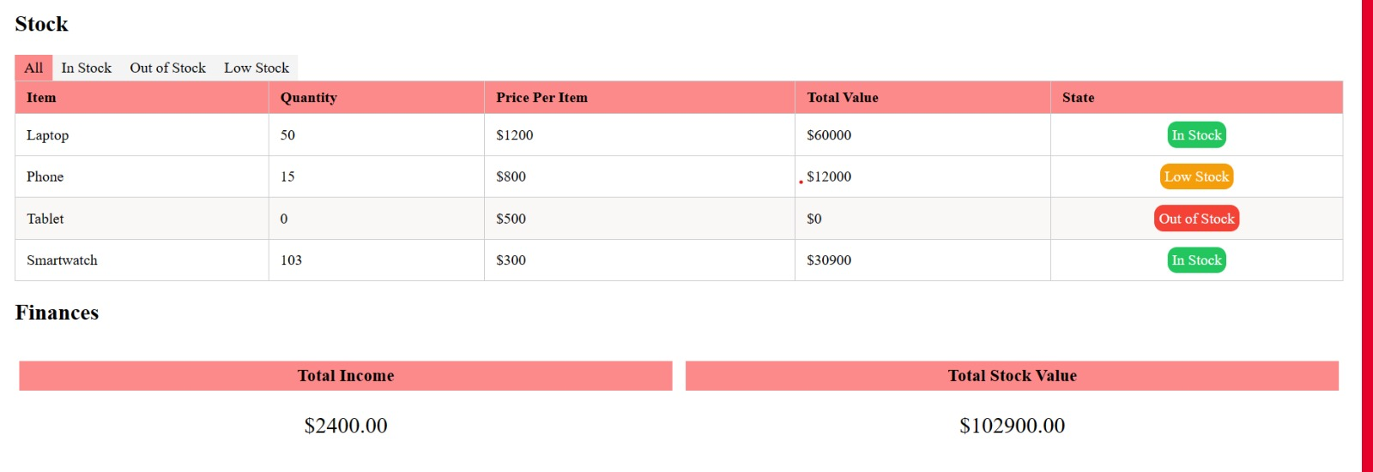
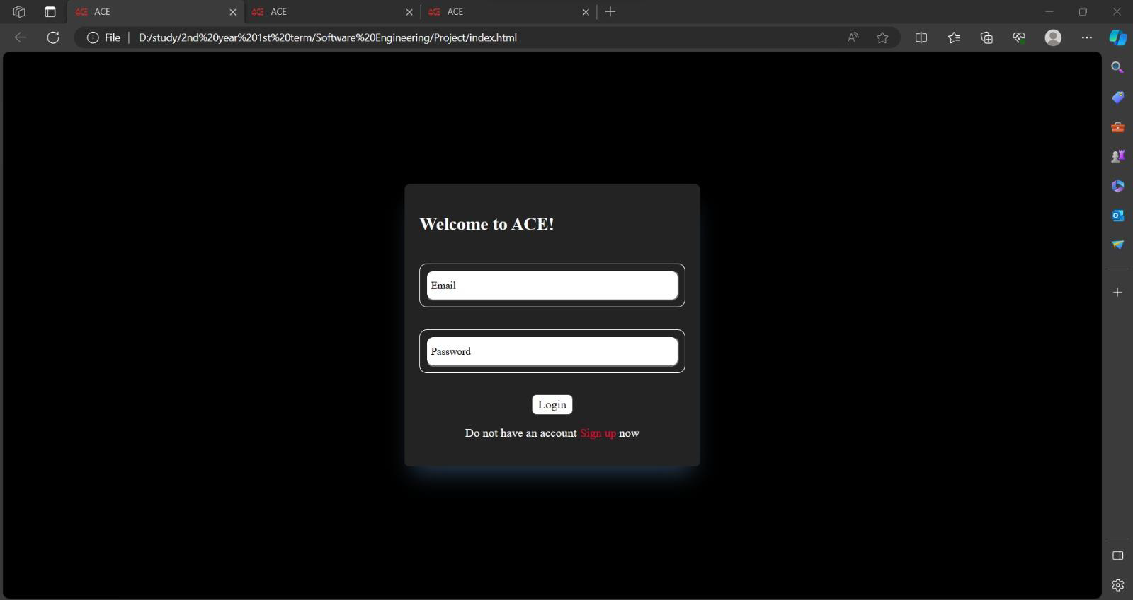
Product infographic

Slide 8
03
Core Functionalities

Slide 9
Core Functionalities
Product Management
Order Management
Streamlines product listing and categorization for enhanced accessibility.
Efficient tracking and processing of orders.
Review and Rating System
Seller Management
Allows customers to share feedback, enhancing trust and quality.
Empowers sellers with tools for managing their products and sales.

Slide 10
04
Performance and Reliability

Slide 11
Performance and Reliability
System Performance
Scalability
Optimized for high efficiency and fast response times.
Designed to seamlessly handle increasing loads and user growth.
Security Measures
System Reliability
Advanced security protocols to ensure safe transactions and data protection.
Robust infrastructure ensuring consistent and reliable service availability.

Slide 12
05
Technical Backbone

Slide 13
Technical Backbone
Modular Architecture Overview
User Management Module
Explains the interconnection and function of different system modules.
Manages user profiles, authentication, and access control.
Product Management Module
Order Management Module
Handles product listings, categorization, and inventory management.
Facilitates order processing, tracking, and fulfillment.

Slide 14
06
Trust and Integrity

Slide 15
Trust and Integrity
Secure Accounting Module
Transaction Safety
Review and Rating System
Ensures the safety and integrity of financial transactions.
Robust security measures to protect against fraud and data breaches.
Builds consumer trust and promotes transparency in product quality and seller performance.

Slide 16
07
Beyond the Basics

Slide 17
Beyond the Basics
Seller Analytics
Warehouse
/Logistics Management
Customer Support
Advanced analytics tools for sellers to track performance and optimize strategies.
Integrated management systems for efficient warehousing and logistics operations.
Robust customer support module ensuring a high level of customer satisfaction and service.

Slide 18
08
A Comprehensive Solution

Slide 19
A Comprehensive Solution
Comprehensive E-Commerce Solution
User-Friendly and Secure
Streamlines product listing and categorization for enhanced accessibility.
Efficient tracking and processing of orders.
Adaptable and Efficient
Impact on E-Commerce Industry
Allows customers to share feedback, enhancing trust and quality.
Empowers sellers with tools for managing their products and sales.

Slide 20
THANK YOU FOR YOUR TIME!
33/33 ;)

